Slide 1

IILM UNIVERSITY, GREATER NOIDA
INTERNSHIP REPORT PRESENTATION
Java Full Stack Developer
Virtual Internship
AICTE – EduSkills Virtual Internship Program | Domain: Java Full Stack Development
Ankit Kumar
Roll No. 2410031066 | B.Tech CSE
April – June 2026

Slide 2






ABOUT THE STUDENT
Candidate Profile
Roll Number
2410031066
Ankit
Kumar
Institute
IILM University, Greater Noida, U.P.
Programme
B.Tech – Computer Science & Engineering
B.Tech CSE, Batch 2024–2028
Internship Domain
Java Full Stack Developer
Duration
8 Weeks | April – June 2026
Java Full Stack Developer Internship • Ankit Kumar
02

Slide 3



ABOUT THE PROGRAM
EduSkills, AICTE & Industry-Aligned Learning
EduSkills Academy is an ISO 9001:2015 and ISO/IEC 20000-1:2018 certified organization working under the theme "Nation Building Through Skills." It partners with the All India Council for Technical Education (AICTE) to run the AICTE–EduSkills Virtual Internship Program under the patronage of the AICTE National Internship Portal. For the Java Full Stack Developer track, EduSkills has designed an industry-aligned curriculum that helps engineering students build practical, job-ready skills in end-to-end web application development.
ISO Certified
AICTE Patronage
Industry-Ready Curriculum
ISO 9001:2015 & ISO/IEC 20000-1:2018 certified organization.
Run under the AICTE National Internship Portal.
Job-ready skills for end-to-end full stack development.
Java Full Stack Developer Internship • Ankit Kumar
03

Slide 4





PROBLEM STATEMENT
Bridging Theory and Full Stack Practice
Although many engineering students learn the theoretical foundations of programming and object-oriented concepts in coursework, very few get structured, hands-on exposure to building a complete web application that integrates front-end, back-end, and database layers using an industry-standard stack such as Java, Spring Boot, and MySQL. Concepts like RESTful API design, server-side programming, and database connectivity are often understood only theoretically.
This internship addressed that gap — practically learning the full Java Full Stack workflow:
→
→
→
→
Core Java & OOP
Front-End (HTML/CSS/JS)
Servlets, JSP & Spring
REST APIs (Spring Boot)
Full Stack Integration
Java Full Stack Developer Internship • Ankit Kumar
04

Slide 5







PROJECT OBJECTIVES
What the Internship Set Out to Achieve
Core Java & OOP
Front-End Development
Servlets, JSP & MVC
Spring Framework
Strengthen core Java programming and object-oriented concepts.
Learn HTML5, CSS3 and JavaScript for web interfaces.
Understand server-side programming and the MVC design pattern.
Learn Dependency Injection and Inversion of Control.
RESTful Web Services
Database Design (JDBC)
Full Stack Integration
Final Assessment
Build and test REST APIs using Spring Boot.
Design relational schemas and integrate via JDBC/MySQL.
Combine front-end, back-end and database into one app.
Clear the Final Assessment / Internship Grade Point Assessment.
Java Full Stack Developer Internship • Ankit Kumar
05

Slide 6


TECHNOLOGIES & TOOLS
The Toolkit Behind the Internship
Java
HTML5 / CSS3
JavaScript
Servlets & JSP
Core language & OOP
Front-end structure & styling
Client-side interactivity
Server-side programming (MVC)
Spring
Spring Boot
MySQL & JDBC
Eclipse / Postman / Git
DI & Inversion of Control
RESTful web services
Relational data & connectivity
Dev, testing & version control
Java Full Stack Developer Internship • Ankit Kumar
06

Slide 7



SYSTEM ARCHITECTURE
From Core Java to a Deployed Web App
Presentation Layer
User interface built using HTML5, CSS3 and JavaScript.
↓
Application / Business Layer
Server-side logic via Servlets, JSP and the Spring Framework.
↓
API Layer
RESTful web services built using Spring Boot.
↓
Data Access Layer
CRUD operations via JDBC against MySQL.
↓
Database Layer
MySQL relational database storing application data.
↓
Assessment Layer
Weekly quizzes, assignments & Final Grade Point Assessment.
Java Full Stack Developer Internship • Ankit Kumar
07

Slide 8
METHODOLOGY
The 8-Week Learning Journey
1
WEEK
2
WEEK
3
WEEK
4
WEEK
Core Java & OOP
Front-End Web Basics
Advanced Java & JDBC
Servlets & JSP
Classes, objects, inheritance, polymorphism, exception handling.
Page structure & styling using HTML5, CSS3, JavaScript.
Collections, multithreading basics, DB connectivity via JDBC.
Dynamic server-side pages and the MVC design pattern.
5
WEEK
6
WEEK
7
WEEK
8
WEEK
Spring Framework
Spring Boot & REST APIs
Database Design
Full Stack Integration
Dependency Injection and Inversion of Control.
Developing and testing RESTful web services.
MySQL schemas and CRUD operations for the app.
Integrating front-end, back-end & database layers.
Java Full Stack Developer Internship • Ankit Kumar
08

Slide 9
EXPECTED OUTCOMES
Skills & Capabilities Gained
Ability to apply core Java and object-oriented programming concepts to real development tasks.
Practical understanding of front-end web development using HTML, CSS and JavaScript.
Hands-on exposure to server-side programming using Servlets, JSP and the Spring Framework.
Capability to design and develop RESTful APIs using Spring Boot.
Skill to design MySQL database schemas and connect them to a Java application using JDBC.
Ability to integrate front-end, back-end and database layers into a complete full stack web application.
Successful completion of the Final Assessment / Internship Grade Point Assessment with an "Excellent" grade.
Java Full Stack Developer Internship • Ankit Kumar
09

Slide 10
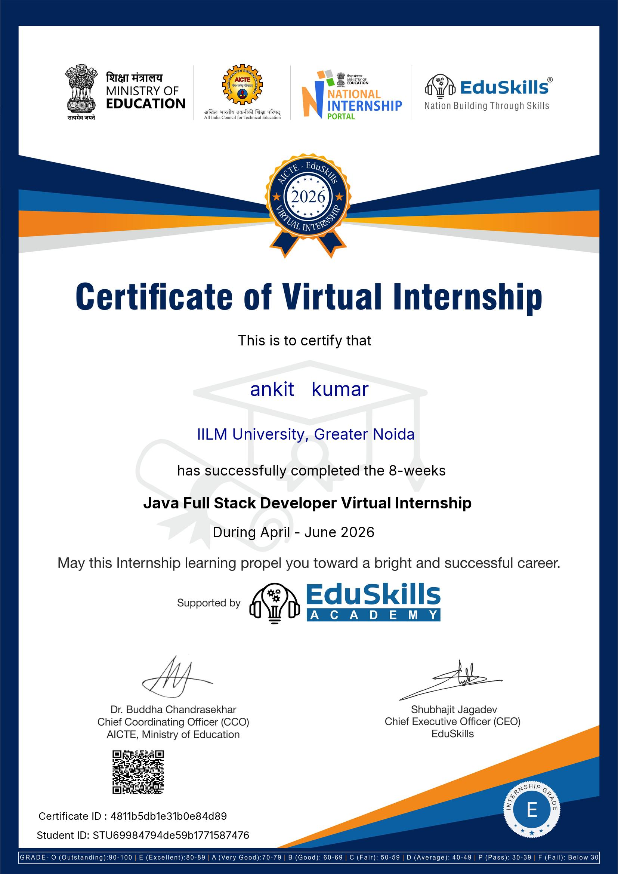




CERTIFICATION
Successfully Completed
Grade
E – Excellent
Certificate ID
4811b5db1e31b0e84d89
Student ID
STU69984794de59b1771587476
Duration
8 Weeks | April – June 2026
Java Full Stack Developer Internship • Ankit Kumar
10

Slide 11
Thank You
Java Full Stack Developer Virtual Internship | AICTE – EduSkills Program
Ankit Kumar
Roll No. 2410031066 | IILM University, Greater Noida

